Slide 1


Location-Based Marketing Success
MEASURING
Check-in to Ballroom E and tweet using #Where20 and #Geotoko

Slide 2

Adarsh Pallian
CEO, Geotoko.com
Founded Geotoko in May, 2010
Located in Vancouver, BC
@pallian on twitter
www.geotoko.com

Slide 3
“simply put, location changes everything.”
- matthew honan, wired magazine

Slide 4
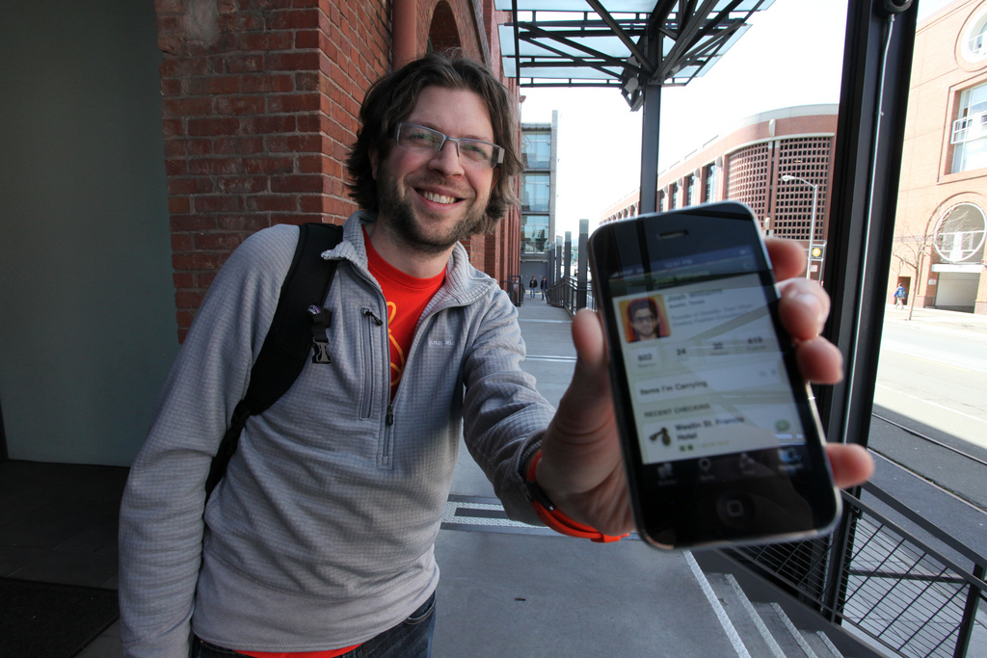
“simply put, location changes everything.”
- matthew honan, wired magazine
The Check-in Landscape

Slide 5
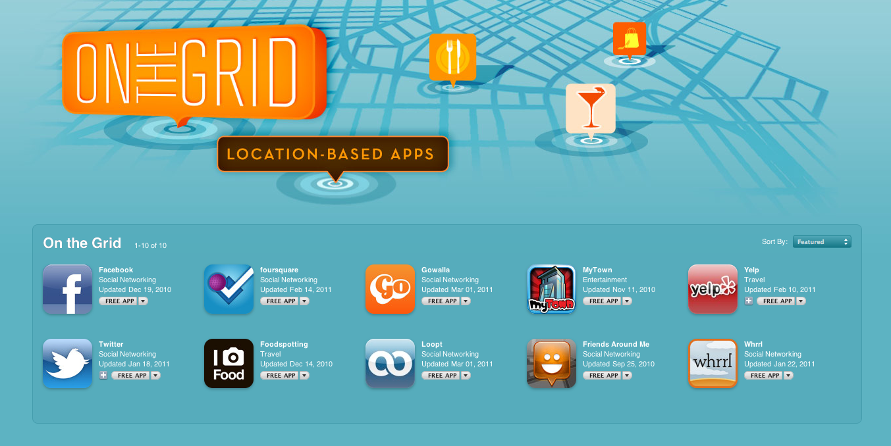
5 Billion Mobile Users Worldwide in 2010
FOURSQUARE
FACEBOOK PLACES
8+ million users, 2 million daily check-ins, 60% US and 40% international
30+ million Facebook Places users,
1.5 million local businesses on FB Places

Slide 6
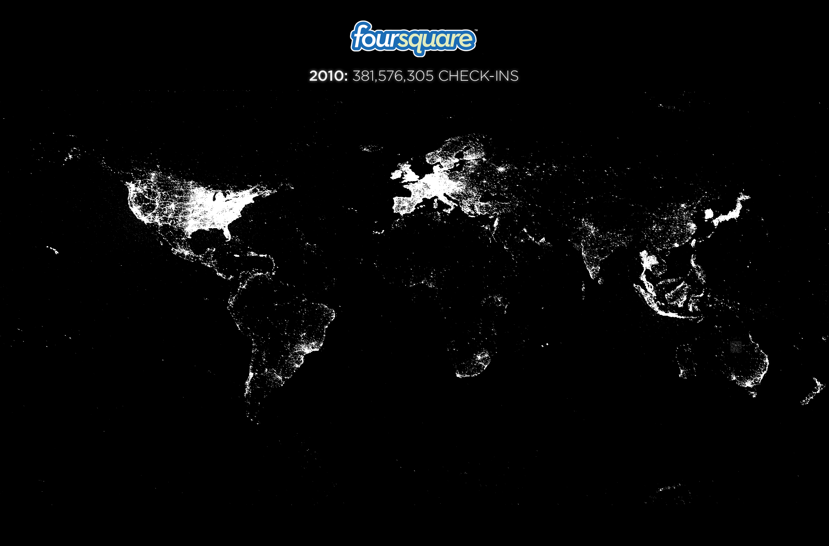
Managing and measuring check-ins, tips, reviews, photos and tweets your
customers leave across all your locations…
THE PROBLEM

Slide 7
… could be a problem.
THE PROBLEM

Slide 8
Welcome, Geotoko

Slide 9
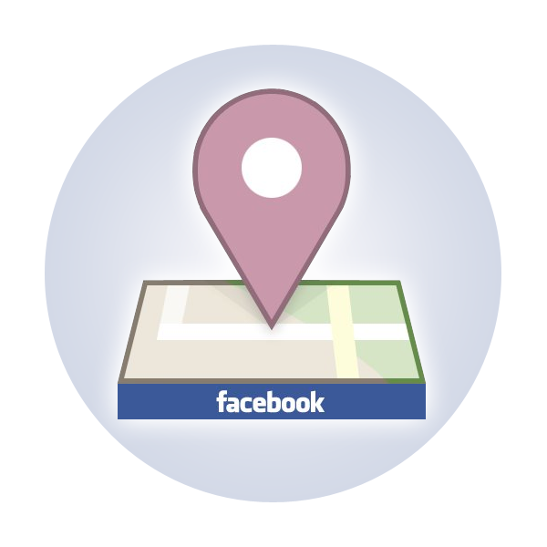

Geotoko provides an easy-to-use web-based dashboard for businesses to create, manage and measure their location-based marketing promotions across multiple platforms and venues.

Slide 10


01 Create
02 Track
Build and distribute deals and promotions on multiple LBS like foursquare and facebook places.
Aggregate in-depth, real-time data to deliver meaningful metrics, actionable insights and measurable ROI
Sweepstakes
Daily Giveaways
Instant Win
Loyal Visitors
Door Crashers
Club card
Intelligence (heatmap)
Geo-Score
Demographics
Location analytics
Social influence
Behavioral patterns

Slide 11
Lets talk analytics.

Slide 12
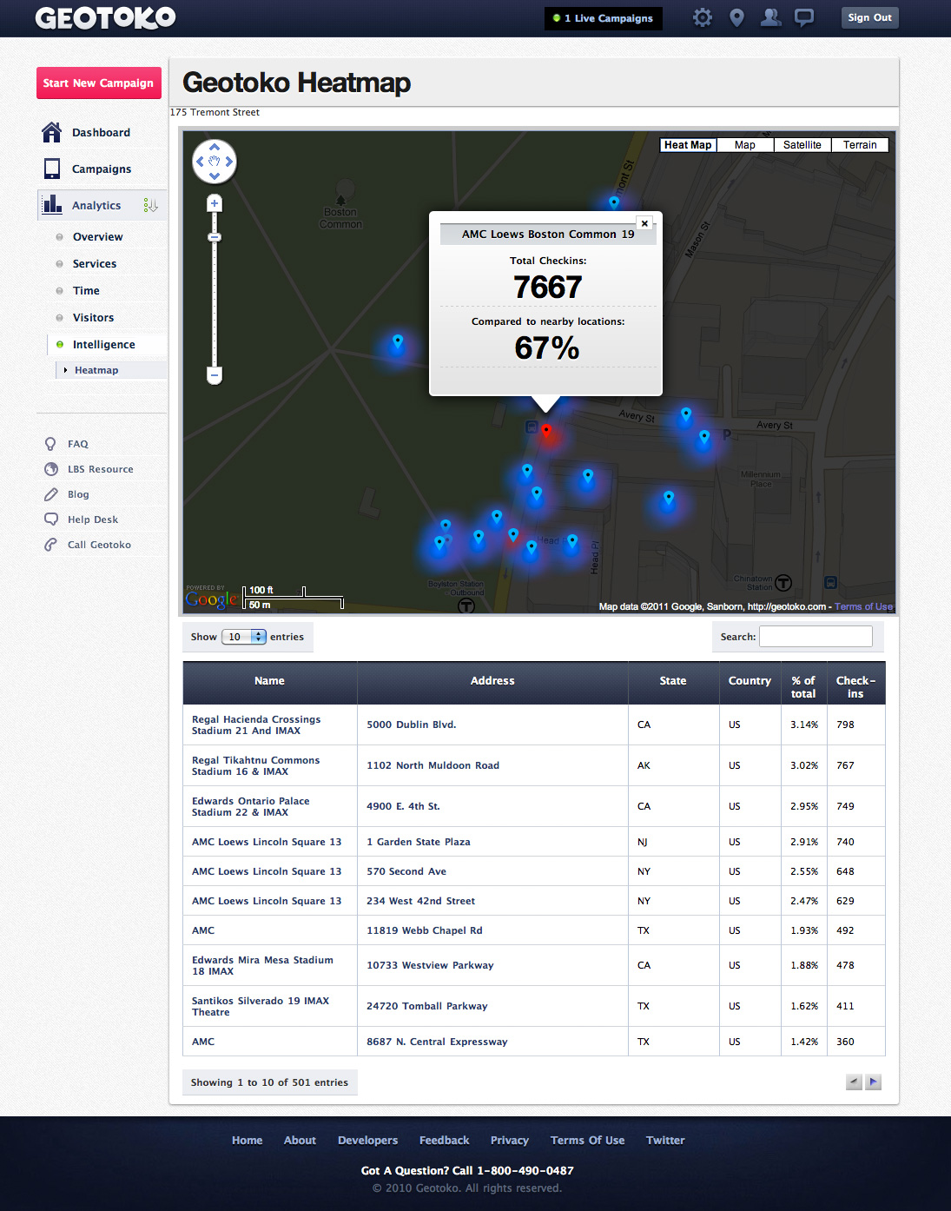

Slide 13
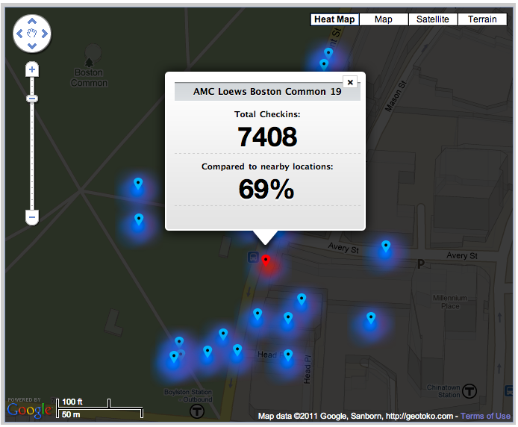
Location Intelligence

Slide 14
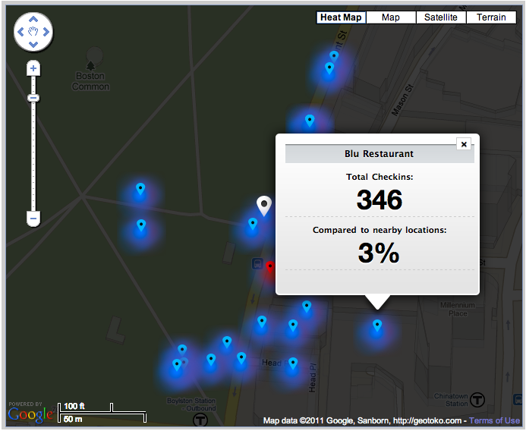
Location Intelligence

Slide 15
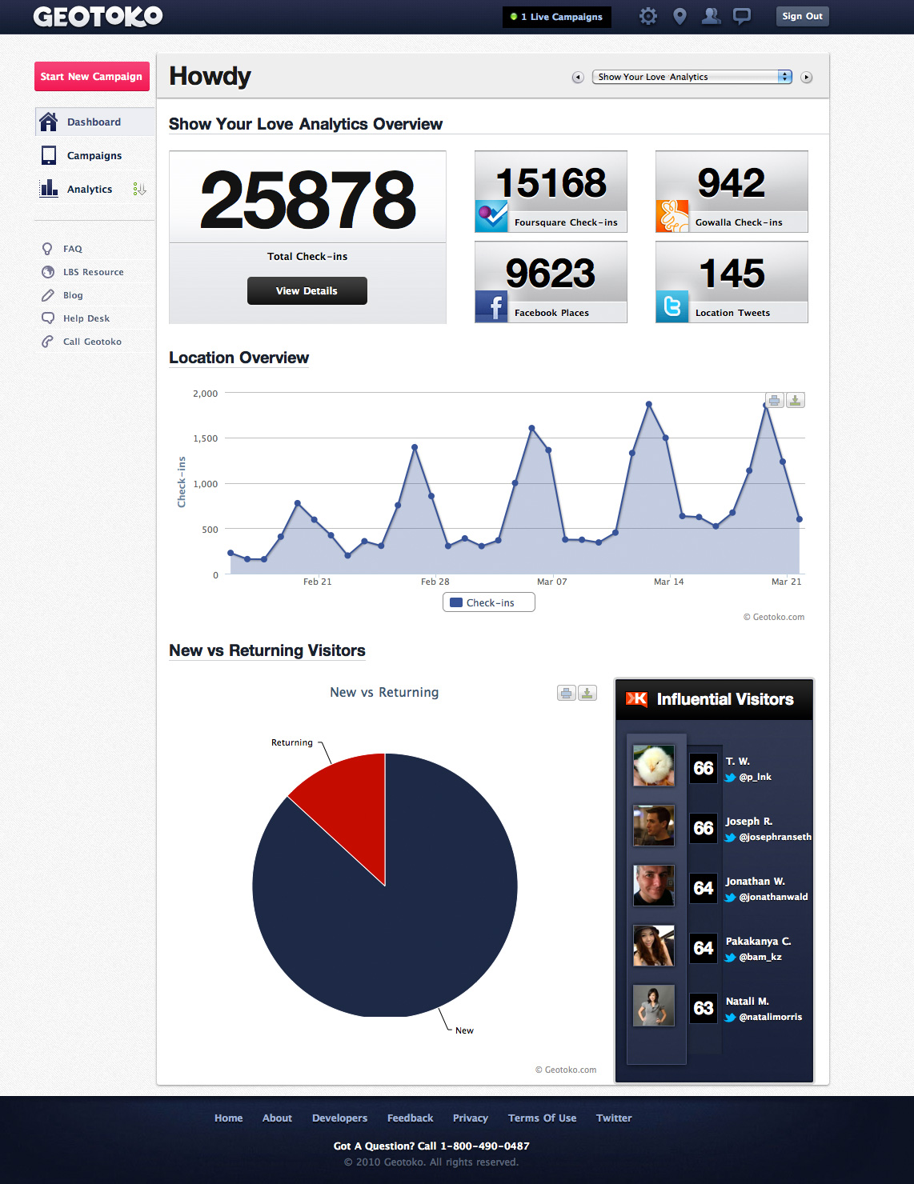

Slide 16
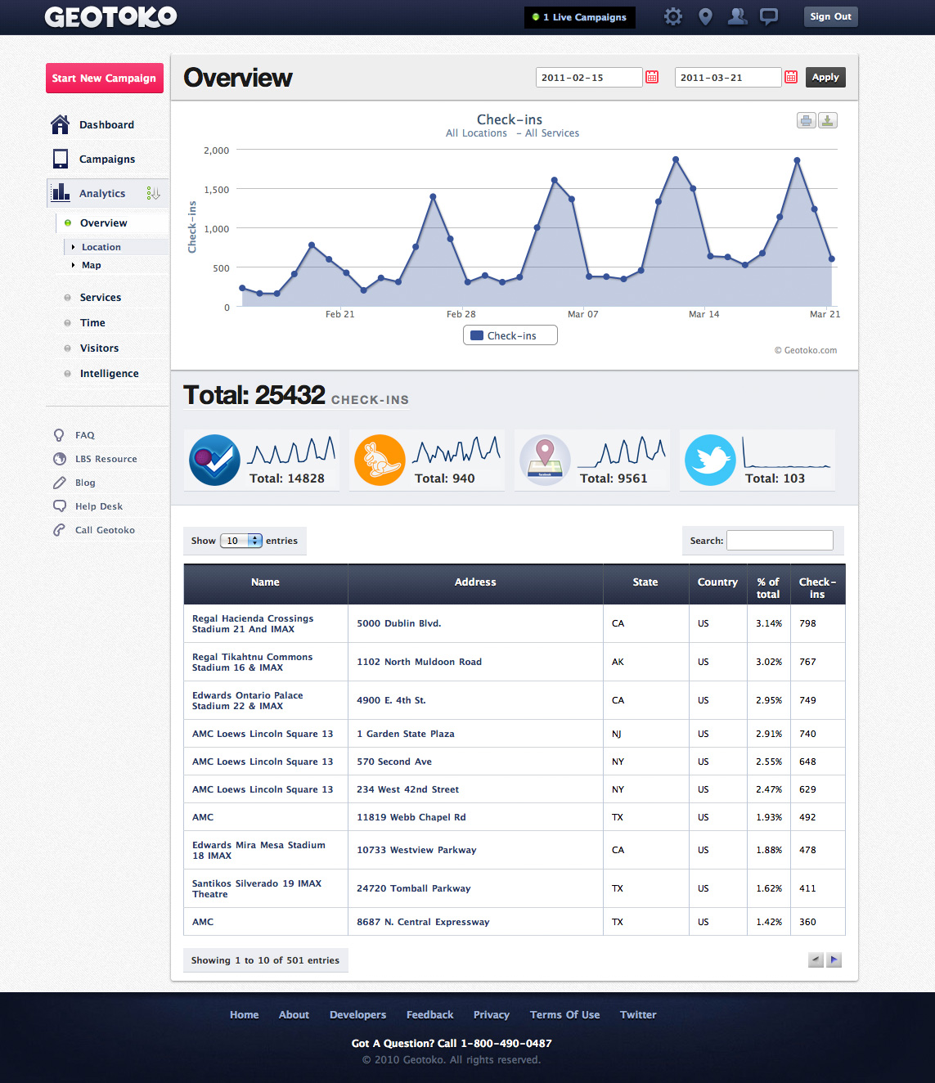

Slide 17
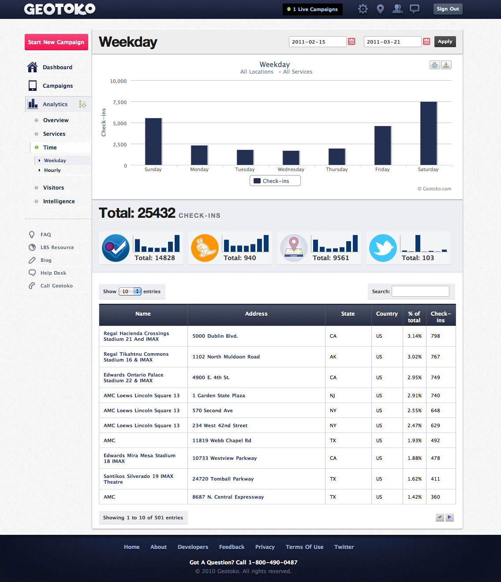

Slide 18
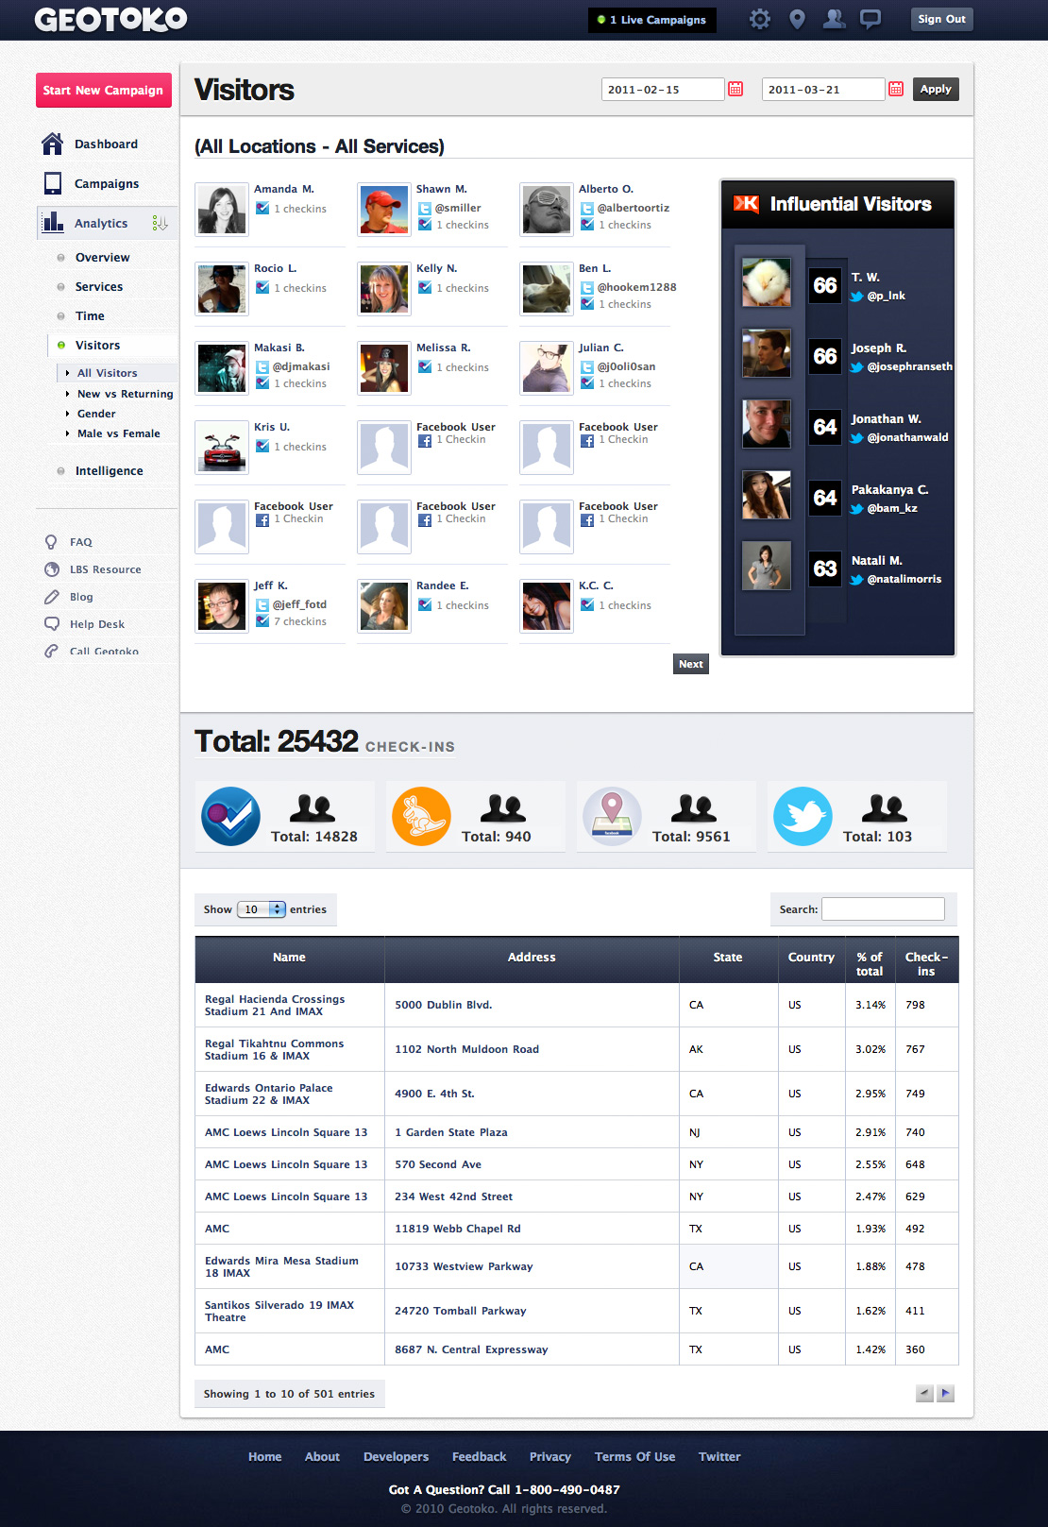

Slide 19
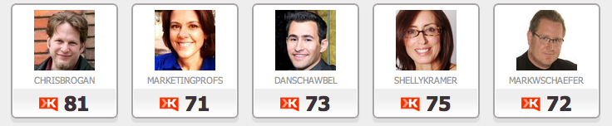
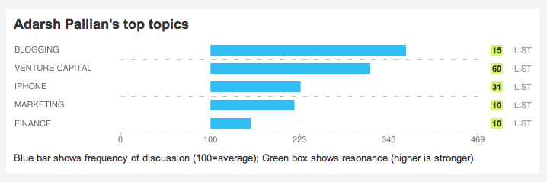
Social Influence

Slide 20
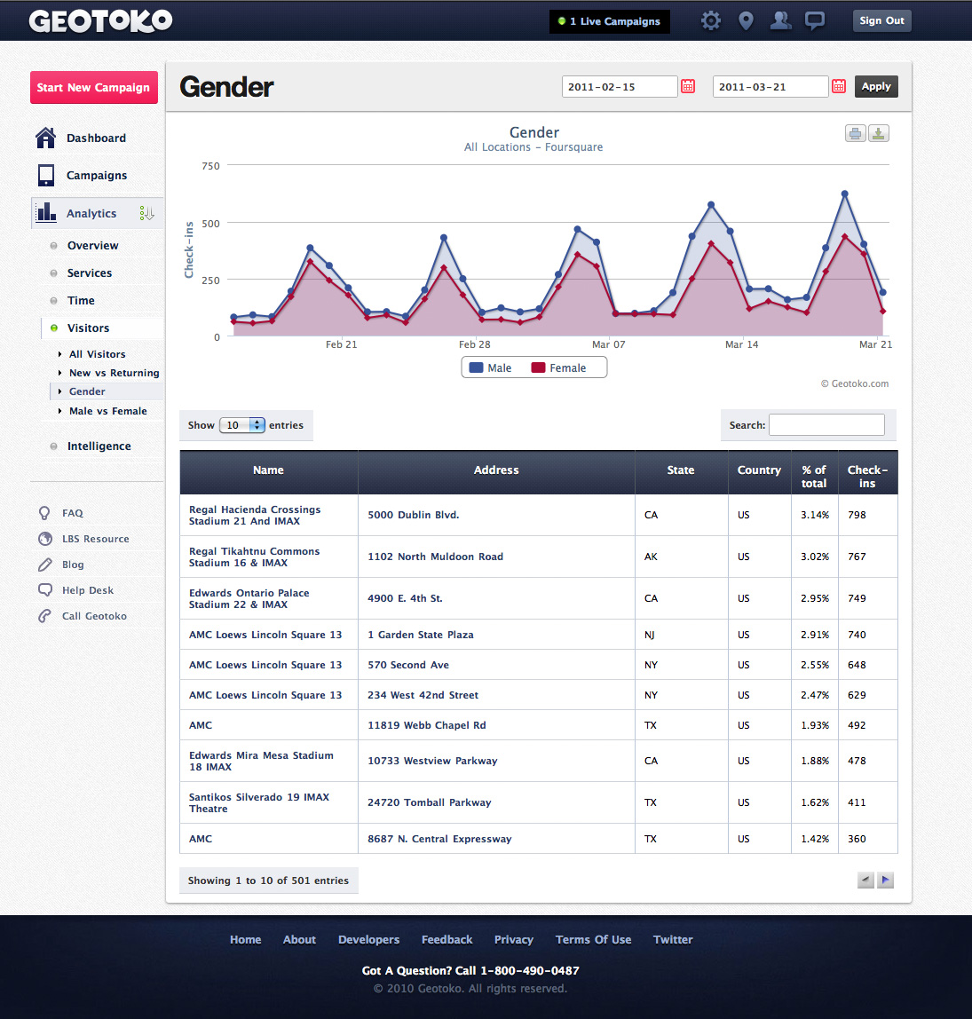

Slide 21

Batch Location Upload
Large businesses can monitor LBS traffic and engagement from multiple sources across
hundreds or thousands of locations
with just a few clicks.

Slide 22
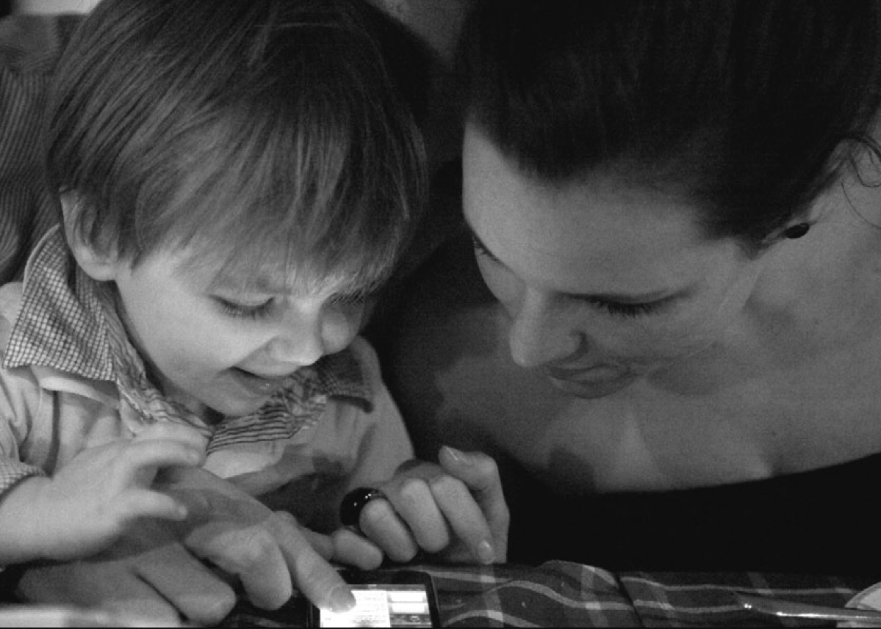
Welcome to the future

Slide 23
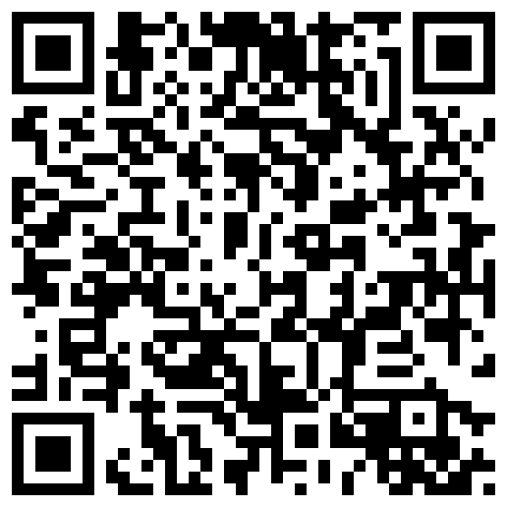
Thank You
adarsh@geotoko.com
778 858 4967
@pallian

